Slide 1
Object Detection and Classification using Neural Networks
By Suruchi Sharma
ISE 244
Under guidance of: Professor Shilpa Gupta

Slide 2
Introduction
My project is based on paper titled as “ CIFAR10 to Compare Visual Recognition Performance between Deep Neural Networks and Humans”
It aims at solving the problem of image recognition/classification using Neural Networks.
This idea of object classification using neural networks may seem to be stereotypical , but the scenario was different before this paper came out. The challenging task was to compare the “visual recognition performance between”Neural Networks and Human beings. It has been stated in the conclusion that neural network models performed better than human beings.

Slide 3
CIFAR 10 Dataset
CIFAR 10 dataset has 60000 images :
50000 images were used for training and validation
10000 images were used for testing
The images are divided into 10 categories and they are, “airplane”, “automobile”, "bird", "cat", "deer", "dog", "frog", "horse", "ship", "truck".

Slide 4
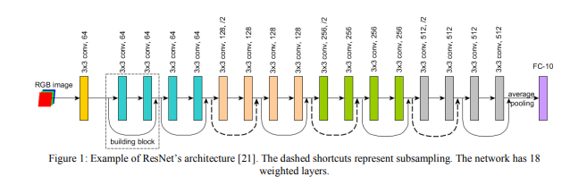
Neural Network Architecture in paper
Adapted from: https://arxiv.org/ftp/arxiv/papers/1811/1811.07270.pdf

Slide 5
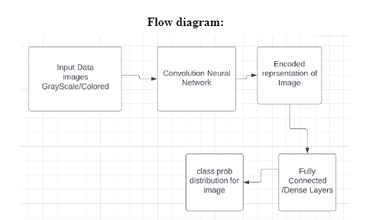
Flow diagram

Slide 6
Images preprocessing
Colored images were normalized by dividing each pixel value by 0,255
In order to convert colored pixel (x1,y1,z1) to grayscale we perform the following operation:
0.229*(x1) + 0.587 *(y1) + 0.114*(z1)

Slide 7
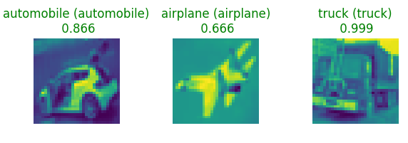
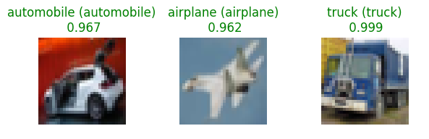
Examples of grayscale images
Examples of colored images

Slide 8
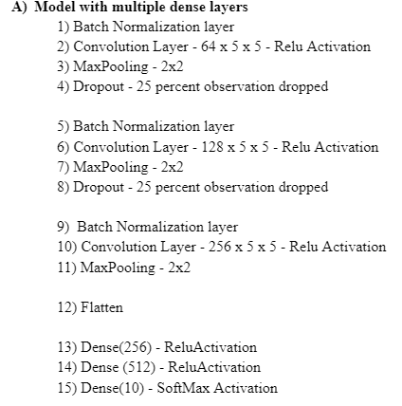
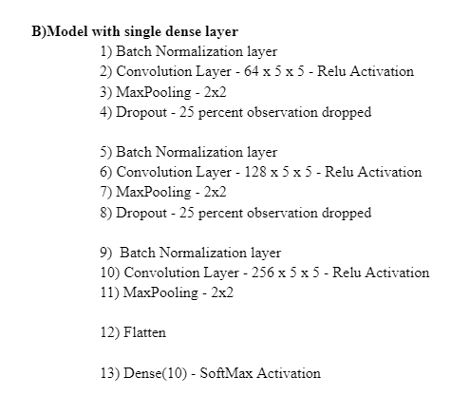
Neural Network Architectures utilized in project

Slide 9
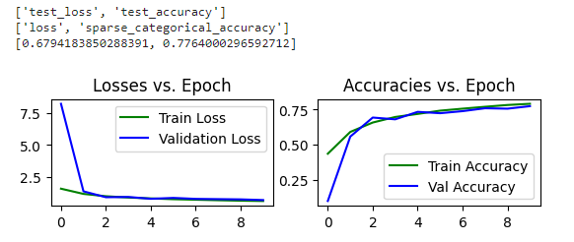
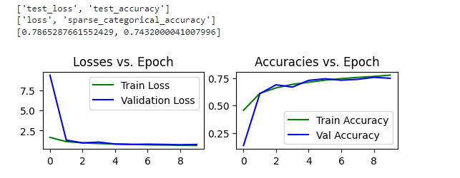
Results - Grayscale images
Grayscale with network having multiple dense layers
2) Grayscale with network having single dense layer

Slide 10
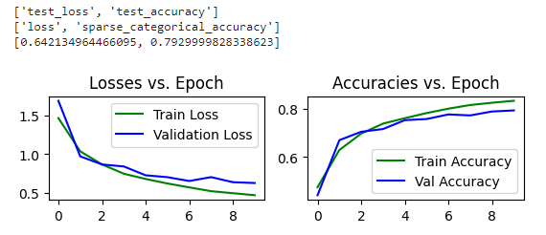
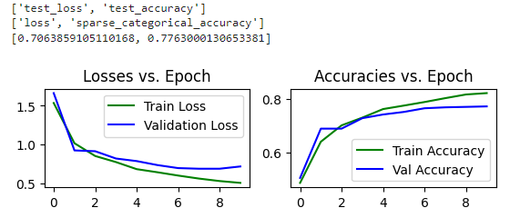
Results Colored images
4) Colored images with network having single dense layer
3) Colored with network having multiple dense layers

Slide 11
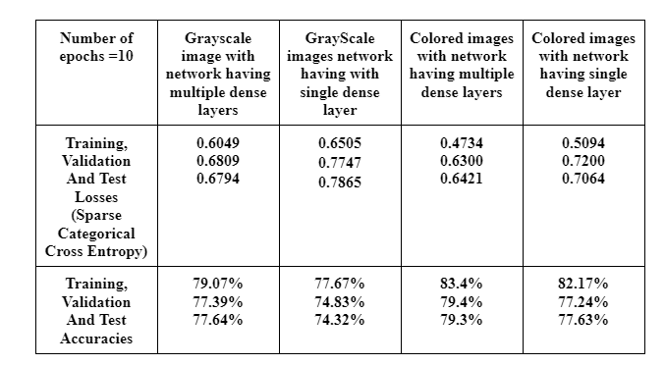
Analysis

Slide 12
Future Scope
Currently there are only 10 objects in dataset , more number of objects can be induced in the dataset.
Accuracy in my system is between 75-80% in future networks giving better accuracy can be designed.

Slide 13
Conclusion
The project was not only about implementing a neural network.
It was about finding a problem statement
Finding relevant research papers
Understanding scenarios before and after the technology was implemented
Then to proceed with my coding and implementation part

Slide 14
Thank you

